Slide 1




CMSC204
Kartchner
V(StateGraph) = {Oregon, Alaska, Texas, Hawaii, Vermont, NewYork, California}
E(StateGraph) = {(Alaska, Oregon), (Hawaii, Alaska), (Hawaii, Texas), (Texas, Hawaii), (Hawaii, California), (Hawaii, New York), (Texas, Vermont), (Vermont, California), (Vermont, Alaska)}
1. Draw the StateGraph
CA
NY
Hawaii
TX
VT
AK
OR

Slide 2
a. Show the adjacency matrix that would describe the edges in the graph. Store the vertices in alphabetical order
States
Alaska
Cali
Hawaii
NY
Oregon
Texas
Vermont
0 0 0 0 1 0 0
0 0 0 0 0 0 0
1 0 1 0 1 0
0 0 0 0 0 0 0
0 0 0 0 0 0 0
0 0 1 0 0 0 1
1 1 0 0 0 0 0
3. b. Show the adjacency lists
that would describe the edges in the graph
AK: [Oregon]
CA: []
HI: [AK, CA, NY, TX]
NY: []
OR: []
TX: [HI, VT]
VT: [AK, CA]

Slide 3
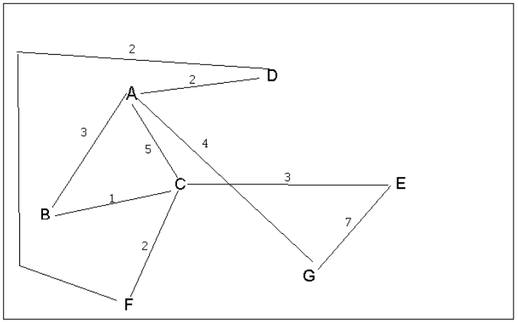
4 a. Which of the following lists the graph nodes in depth first order beginning with E?
A) E, G, F, C, D, B, A
B) G, A, E, C, B, F, D
C) E, G, A, D, F, C, B
D) E, C, F, B, A, D, G
4 b. Which of the following lists the graph nodes in breadth first order beginning at F?
A) F, C, D, A, B, E, G
B) F, D, C, A, B, C, G
C) F, C, D, B, G, A, E
D) a, b, and c are all breadth first traversals

Slide 4
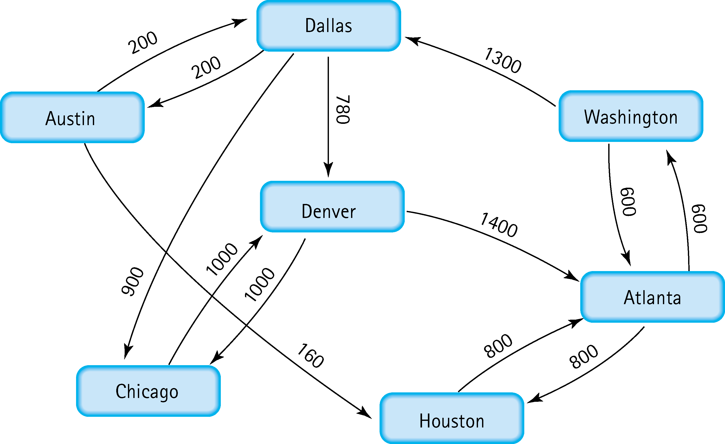
5. Find the shortest distance from Atlanta to every other city
ATL - Washington-Dallas-Austin : 2100
ATL - Washington-Dallas-Chicago : 2800
ATL - Washington-Dallas : 1900
ATL - Washington-Dallas-Denver : 2680
ATL - Houston : 800
ATL -Washington : 600

Slide 5
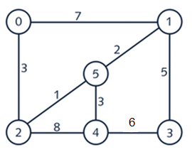
6. Find the minimal spanning tree using Prim’s algorithm. Use
0 as the source vertex . Show the steps.
Minimum of Vertex 0 is 0 to 2, which is 3. Find minimum of Vertex 2 which is 1. Minimum of Vertex 5 is 1. Minimum vertex of 1 is 3. Minimum vertex of 3 is 6 since we already went to vertex 1.

Slide 6
7. Find the minimal spanning tree using Kruskal’s algorithm.
Show the weights in order and the steps.
V2 to V5, V5 to V1.
V2 to V0, V5 to V4
V1 to V3

Slide 7
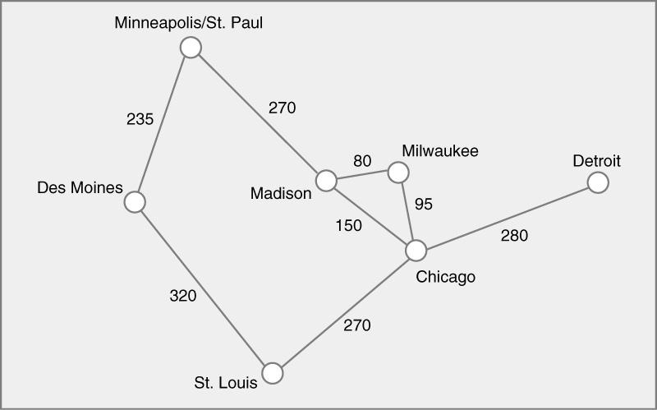
8. Find the minimal spanning tree using the algorithm you prefer. Use
Minneapolis/St. Paul as the source vertex
Kruskals:
Madison – Milwaukee: 80
Milwaukee – Chicago: 95
Minneapolis/St. Paul – Des Moines: 235
Chicago – St. Louis: 270
Minneapolis/St. Paul – Madison: 270
Chicago – Detroit: 280

Slide 8
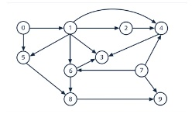
9. List the nodes of the graph in a breadth first topological ordering. Show the
steps using arrays predCount, topologicalOrder and a queue
Indegree: 0 | 1 | 1 | 3 | 3 | 2 | 2 | 0 | 2 | 2
Array – pred – count = 0, 1, 2, 3, 4, 5, 6, 7, 8 ,9
Push 1 to queue, Delete node 1 and add to order, push node 5 and 6 to queue, delete node 5 from queue and add to order, delete node 6 and add to order, push all noes with indegree 1 to the queue, push node 4 from queue, delete node 3 from queue, delete node 8 and add to order, delete node 9 and node 4 and add to order.
Topological Order: 0 | 7 | 1 | 5 | 6 | 2 | 3 | 8 | 9 | 4

Slide 9

10. List the nodes of the graph in a breadth first topological ordering.
Start – Programming – Discrete Math – Computer Organization – Programming 2 – OS – HL Language – Algorithm – Compilers – Senior Seminar – Theory of Computation - End

